Slide 1



INTERNATIONAL INSTITUTE OF MANAGEMENT STUDIES, PUNE
Company Presentation on
Presented by:-
Arya Jain
Sagar Kumar
Priti Paul
Shubham Gole
Amazon
PGDM Batch: 2024-2026
Division: B

Slide 2
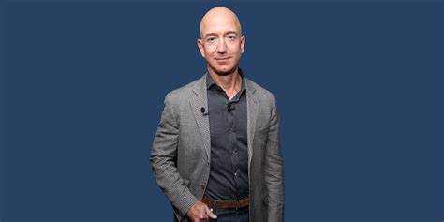
Company Overview
Amazon launched its first product, the Amazon kindle.
Amazon diversified its product and services by its expansion into cloud computing, entertainment, hardware, healthcare, and more.
Amazon's ability to sustain market penetration comes from a well-rounded approach that includes customer focus, innovation, economies of scale, competitive pricing and efficiency.
Amazon uses dynamic pricing , third-party sellers, amazon prime , one click ordering , digital advertising ,etc.
FOUNDER- Jeff Bezos
YEAR- July 5, 1994
HEADQUARTERS – Seattle ,
Washington and
Arlington , Virginia
AREA SERVED – Worldwide

Slide 3
Domestic & International Presence
Domestic
Amazon in India
Launch Year: 2013
Website: Amazon.in
Amazon India is one of the company’s fastest-growing and most important markets.
Amazon has invested heavily in infrastructure, logistics, and new services to capture a large share of India’s burgeoning e-commerce market.
International
Headquarters: Seattle, Washington, USA
Launch Year: 1994
Website: Amazon.com
The U.S. is Amazon’s largest market and where most of its operations are based.
The company’s operations are structured around various services, including e-commerce, cloud computing, digital streaming, and logistics, among others.

Slide 4

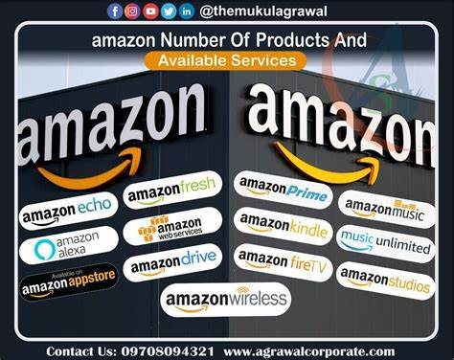
Basic Operation of Amazon
E-commerce Platform (Marketplace Operations)
Logistics and Fulfilment
Amazon Prime Membership
Cloud Computing Services (Amazon Web Services - AWS)
Payments and Financial Services
Artificial Intelligence and Automation
Advertising Business

Slide 5
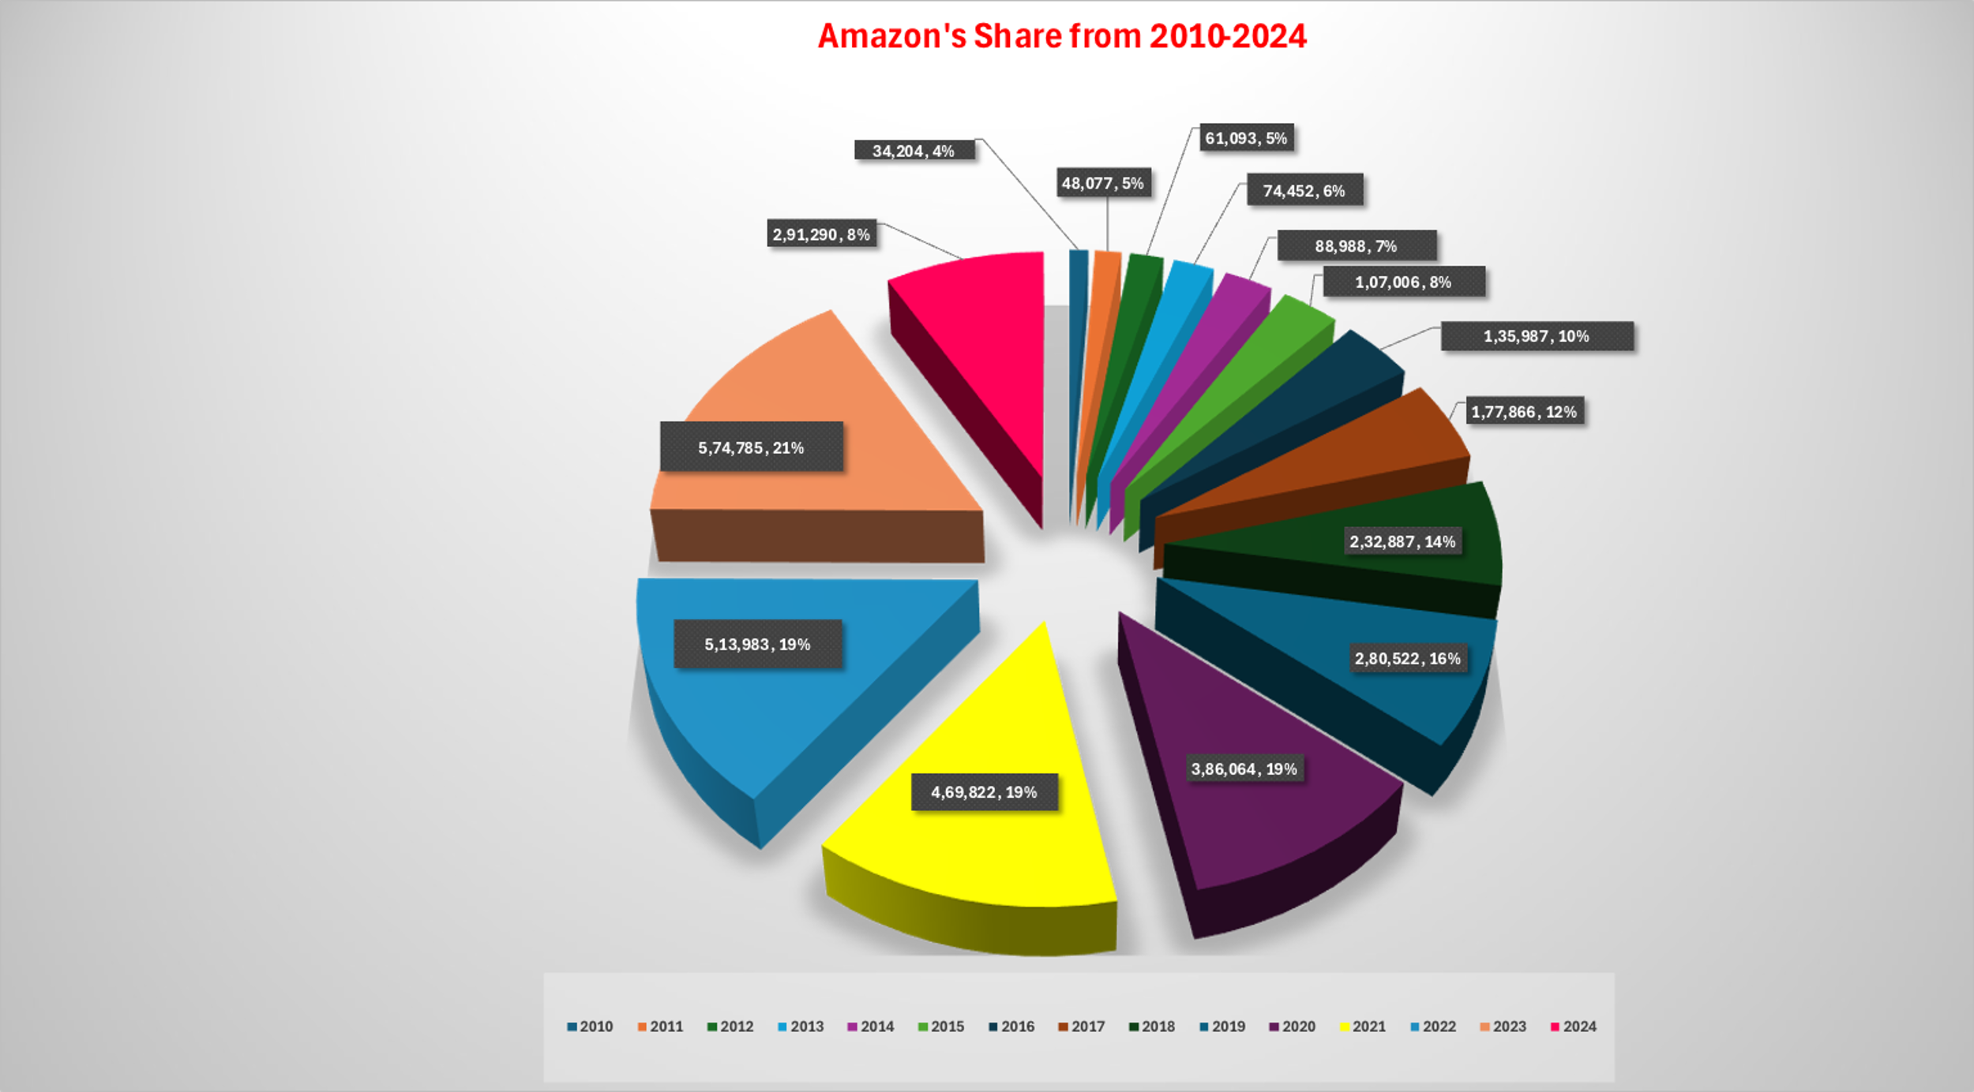
Market Size

Slide 6
Product Line Of Amazon
E-Commerce (Online Retail)
Amazon Logistics
Amazon Prime
Amazon Pharmacy
Amazon Web Services (AWS)
Amazon Pay
Amazon Devices
Amazon Business
Amazon Fresh and Amazon Go

Slide 7




BCG MATRIX
STAR High hold on Market Share ( online store) Cloud Computing Amazon web services | QUESTION MARK Amazon live & video both have not establish their market performance.
CASH COW Amazon e-book & kindle Audiobooks & movies on demand (stable source of income & not showing so much growth) | DOG Alexa (significant market share smart speaker market but growth rate decreased).

Slide 8
Segmentation , Targeting and Positioning
Segmentation
Type Of Segmentation | Segmentation Criteria
Geography | Global | Density
Demographic | All age group | Corporate & industry professional
Behavioural | Allegiance Personality | Benefits sought User Status
Psychographic | Social class | Lifestyle

Slide 9
Targeting
Two ways customer-producer
Generation Z: Specifically, 13-17-year-olds, a dynamic and tech-savvy group.
Over 50% of Amazon’s consumers return for more purchases, showing its strong customer retention
Positioning
Wide Selection: From niche markets like books to virtually everything a customer could need.
Unbeatable Value: Low prices, unparalleled convenience, instant access.

Slide 10

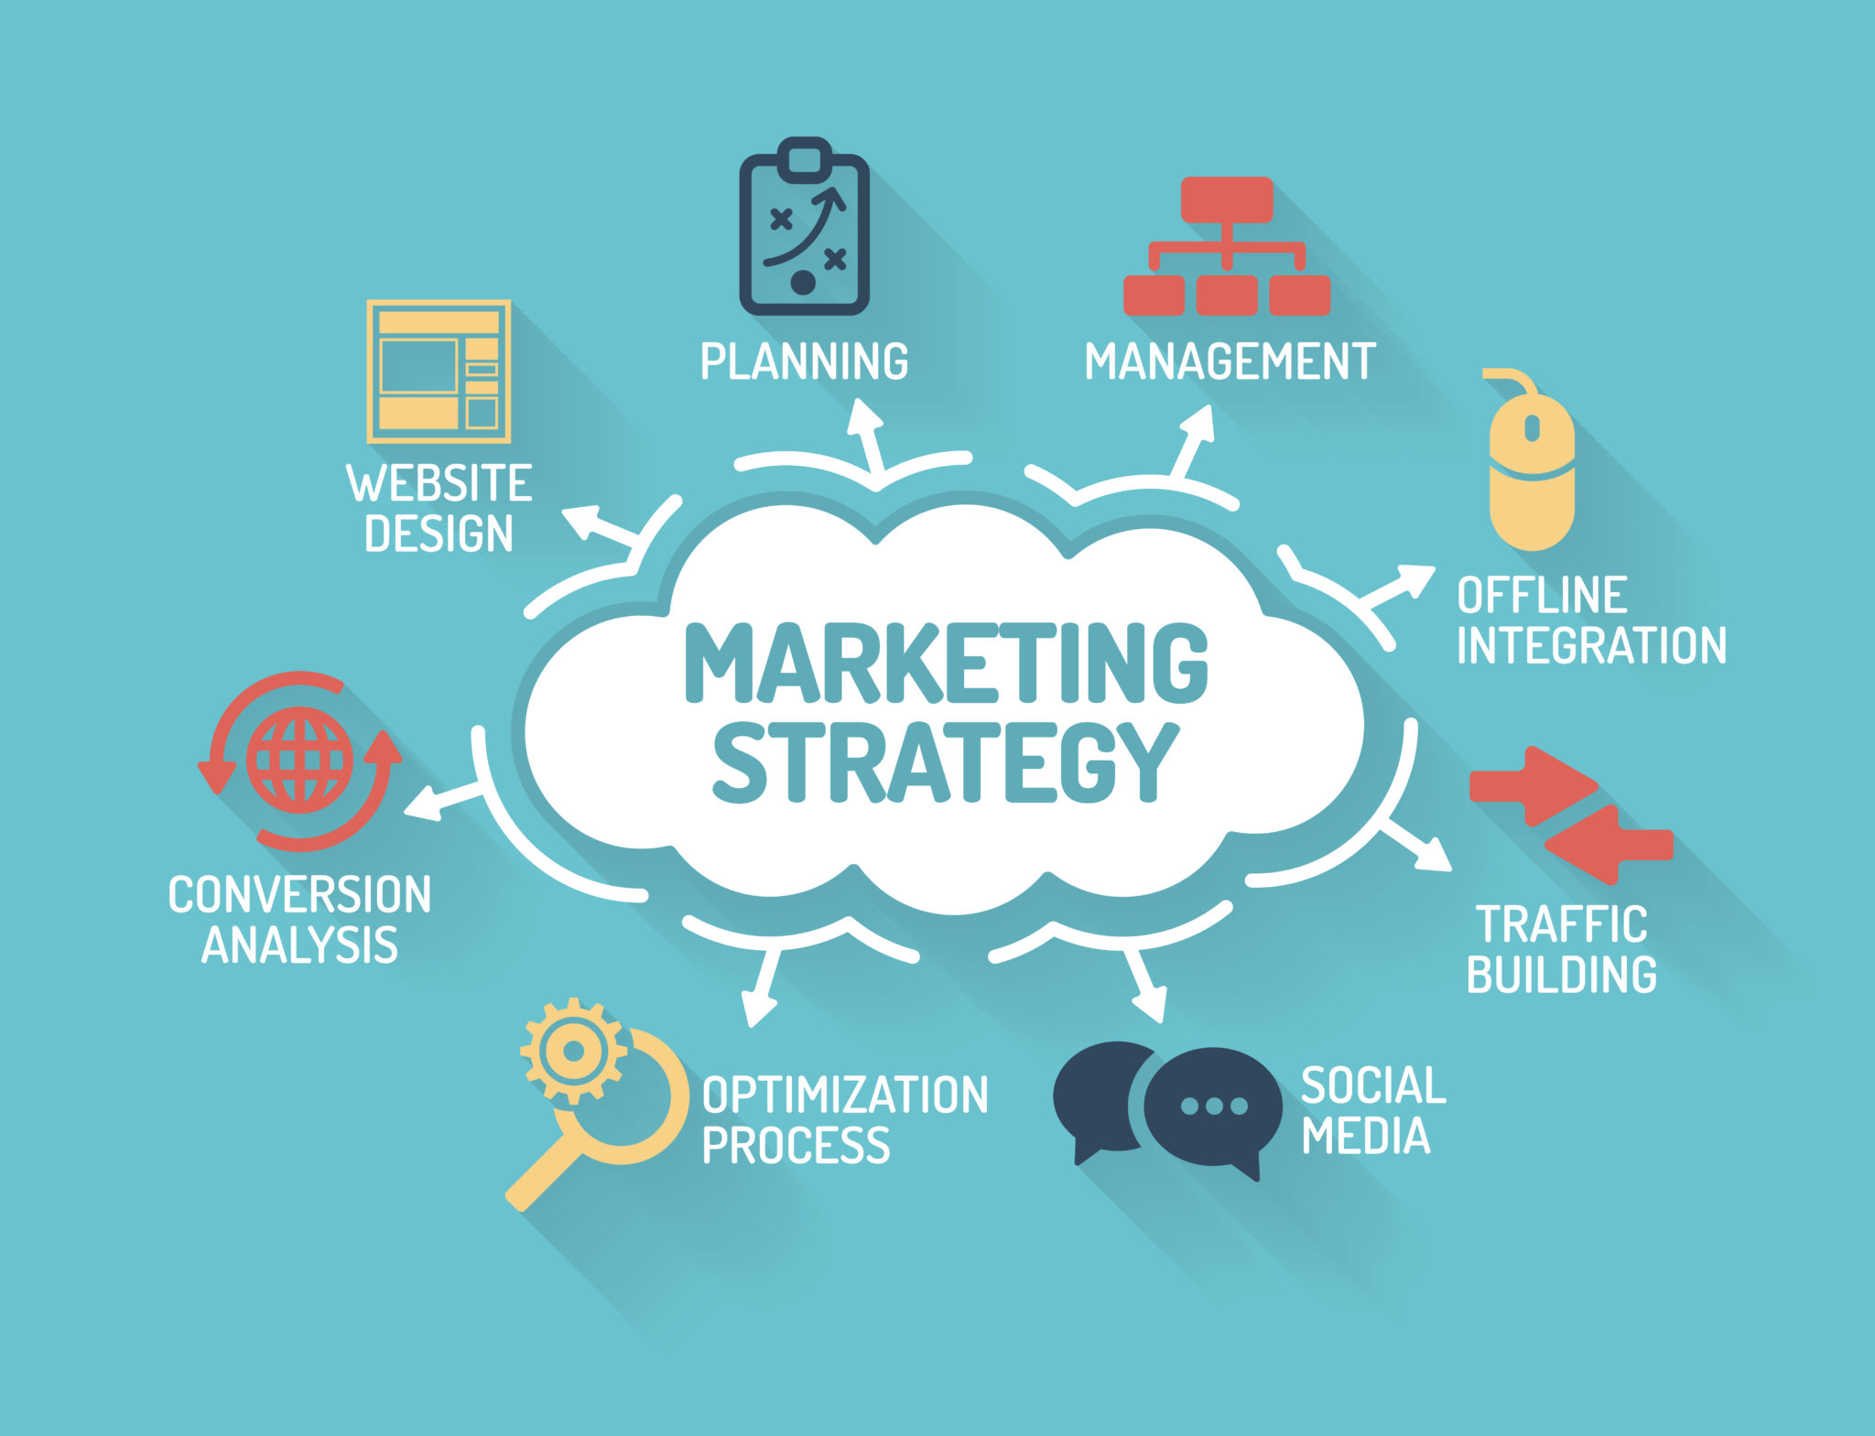
Marketing Strategies
Video Marketing
Social Media Marketing
Influencer Marketing
Email Marketing
Pay Per Click Marketing
Through The Line Advertisement

Slide 11
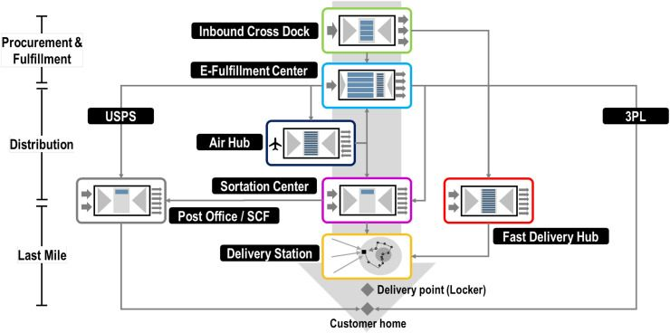
Distribution Channels
The first stage involves procurement with the primary purpose of stocking e-fulfillment centers with the required inventory.
The second stage is the distribution of parceled orders towards facilities near the final delivery point.
The third stage is known as the last mile that brings parcels to their final destination, mainly through delivery routes from specialized facilities.

Slide 12
Future Prospects and Collaboration
Future Prospects
Amazon expands globally, enhancing customer experience and delivery efficiency in emerging markets.
Amazon Web services AWS focuses on cloud growth, AI, edge computing,5G,and sustainability.
Tech advancements power autonomous delivery via drones and robots.
Collaboration
Amazon partners for success, streaming logistics and delivery for a global customer base.
Amazon collaborates with startup, enabling digital transformation through AWs activate.

Slide 13
Conclusion
Amazon is a global leader in e-commerce, cloud computing, digital streaming, and artificial intelligence, with operations in over 100 countries. Its core business revolves around its online retail platform, offering a vast range of products and services to consumers and businesses. In addition to e-commerce, Amazon has diversified its business through its cloud service division (Amazon Web Services - AWS), digital content, and devices like Kindle, Alexa, and Fire TV. By leveraging its global reach, technological advancements, and customer-focused strategies, Amazon is poised to remain a leader in digital commerce and cloud services, with significant future prospects across multiple industries.

Slide 14
Bibliography
amazon current market value - Search (bing.com)
https://1drv.ms/x/s!At1KrqaBqlEqm2mNvY9CDsVEN8Ri
https://www.macrotrends.net/stocks/charts/TGT/target/revenue
amazon - Search Images (bing.com)
distribution channel of amazon - Search (bing.com)
BCG Matrix of Amazon - Strategic Analysis Hub
Container Shipping (pinterest.com)
amazon products - Search Images (bing.com)

Slide 15
THANK YOU

